Slide 1


CNN RNN & LSTM
KARMUKILAN D K
Deep2Neuron Internship

Slide 2

HOW NEURAL NETWORK WORKS ???

Slide 3
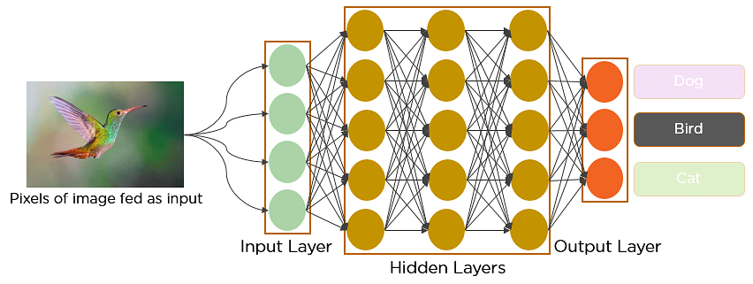
EXAMPLE OF CNN CLASSIFICATION

Slide 4
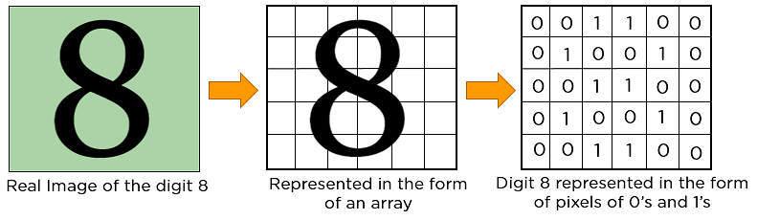
SINGLE CHANNEL

Slide 5
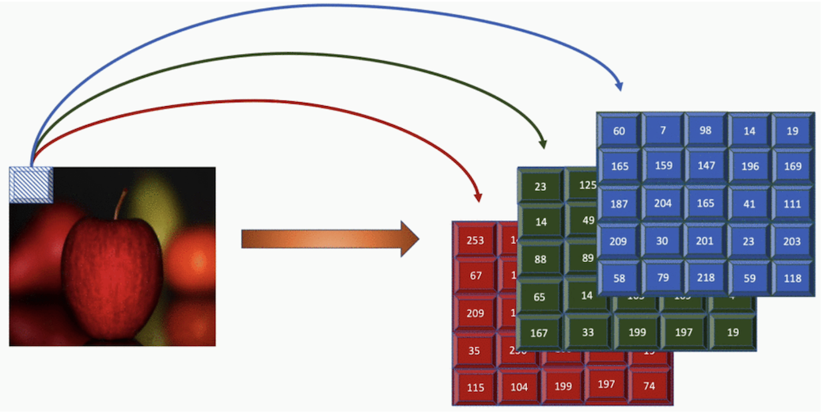
THREE CHANNEL -RGB

Slide 6
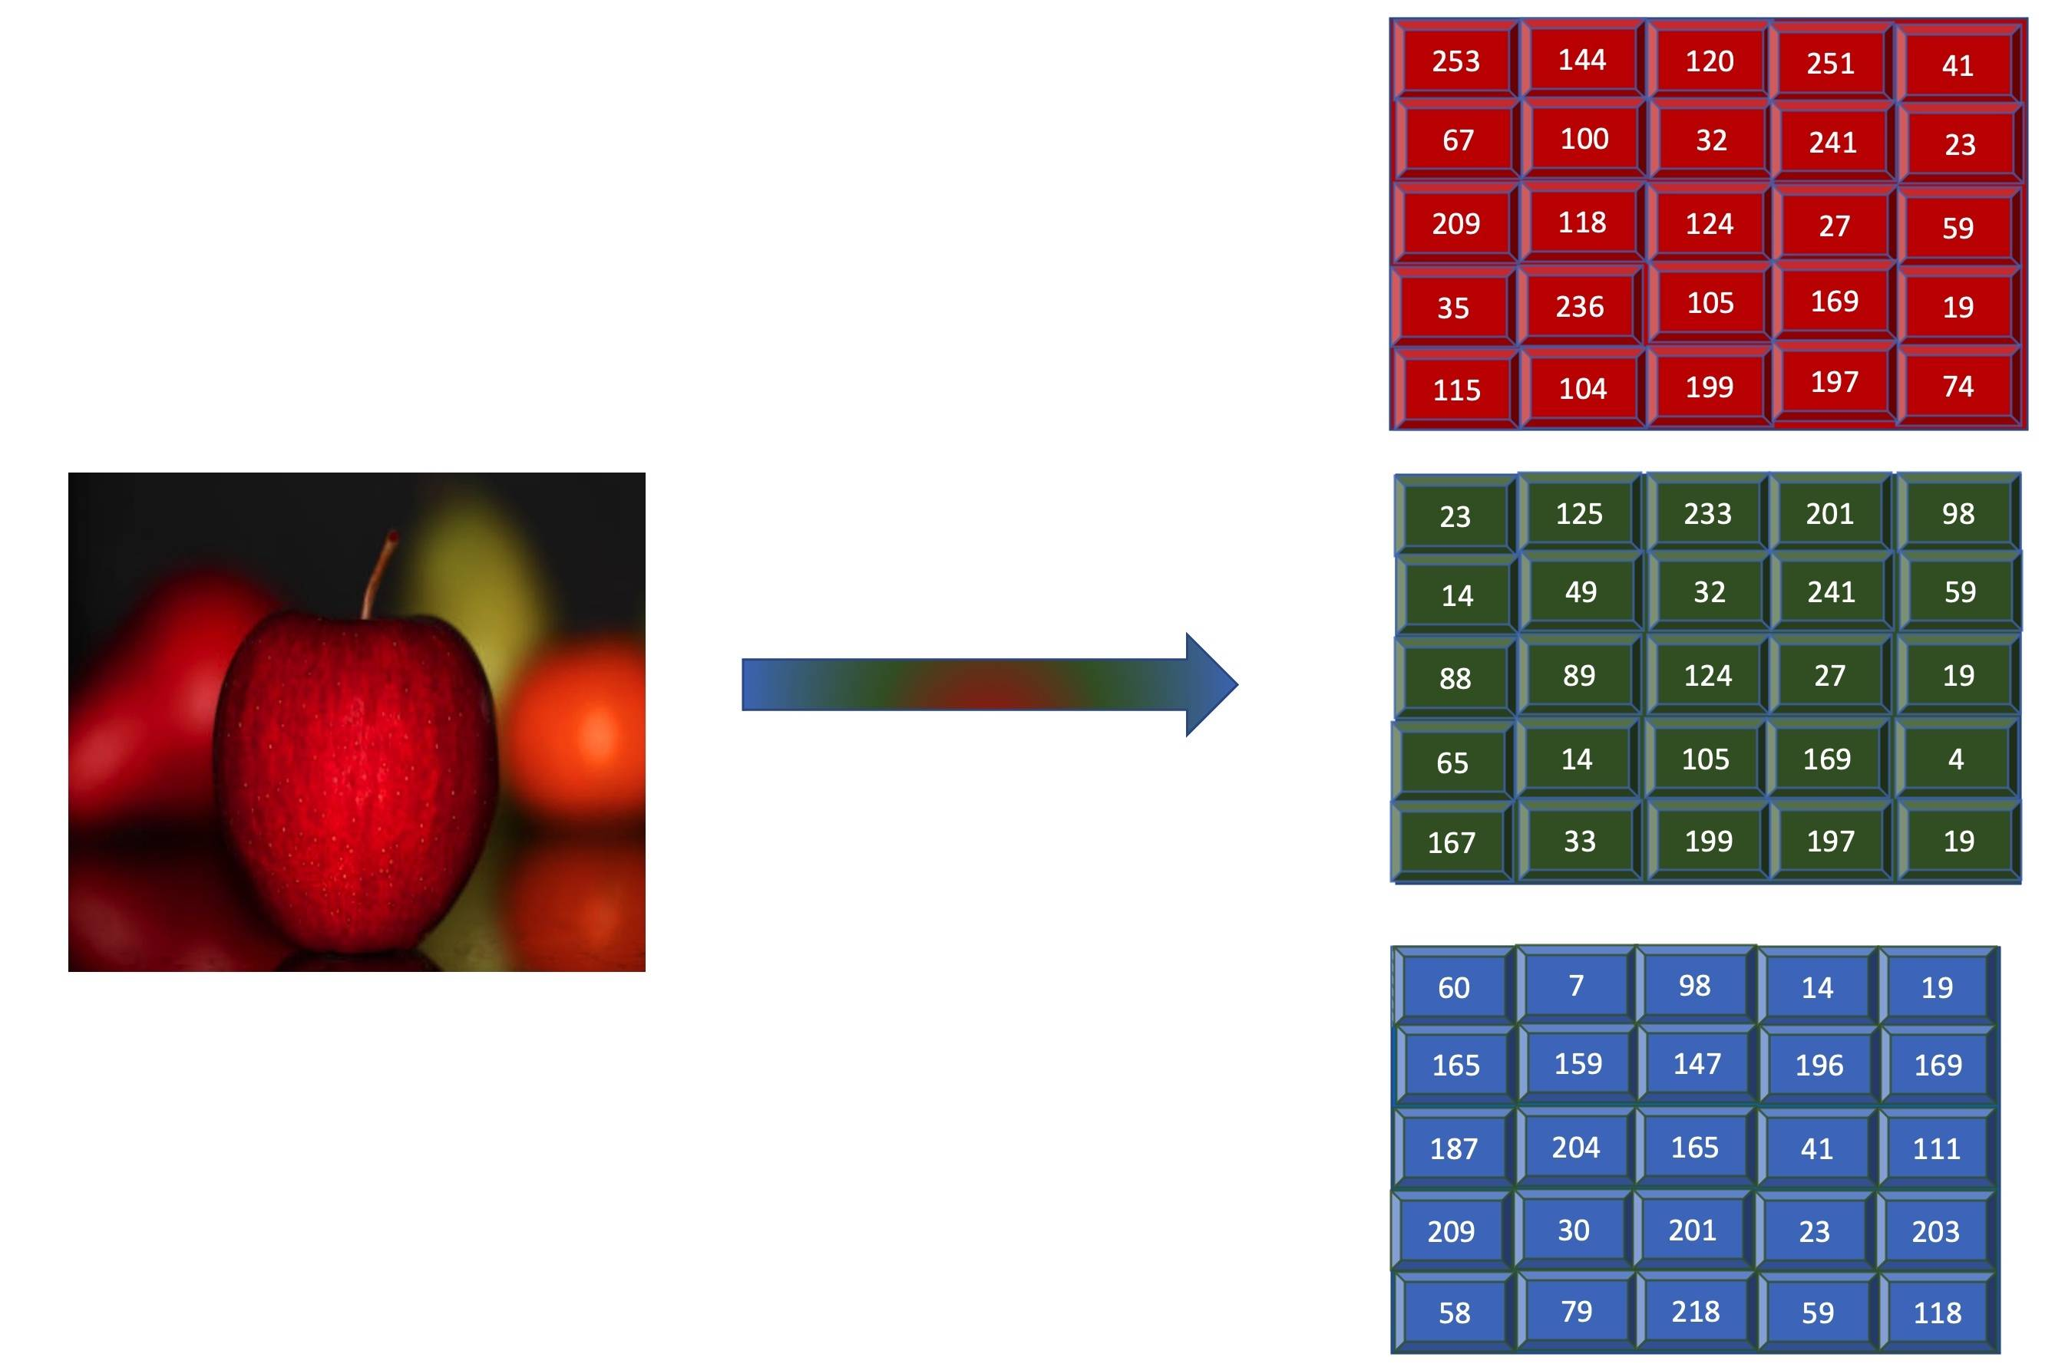

Slide 7
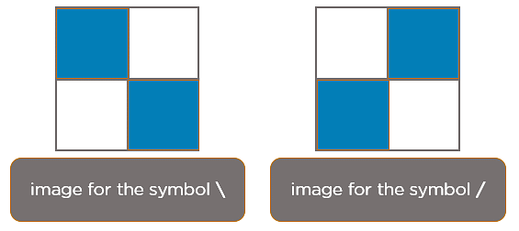
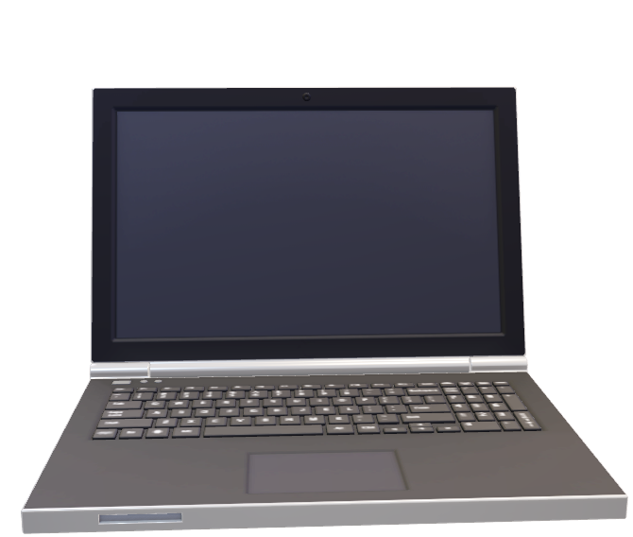
How Does CNN Recognize Images?
Have you noticed what happens behind the computer ???

Slide 8
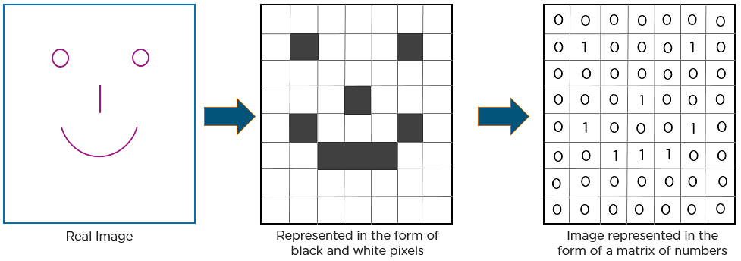
another example…
As you can see from the above diagram, only those values are lit that have a value of 1.

Slide 9
Layers in a Convolutional Neural Network…
Convolution Layer
ReLU Layer
CNN
Fully Connected Layer
Pooling Layer

Slide 10
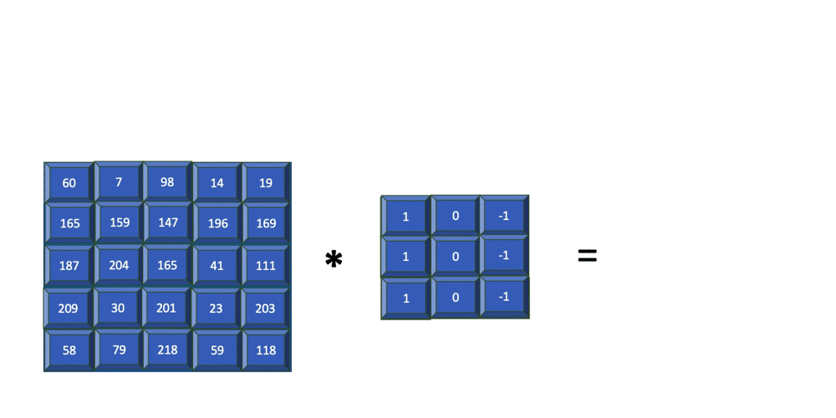
Convolution Layer…

Slide 11
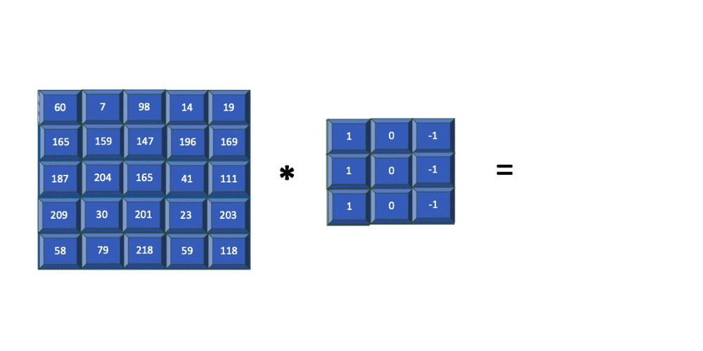
Striding…

Slide 12
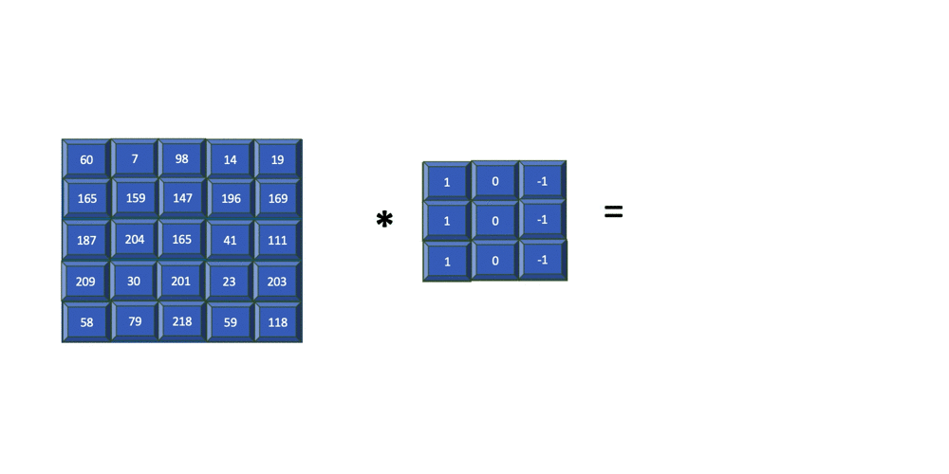
Padding…

Slide 13
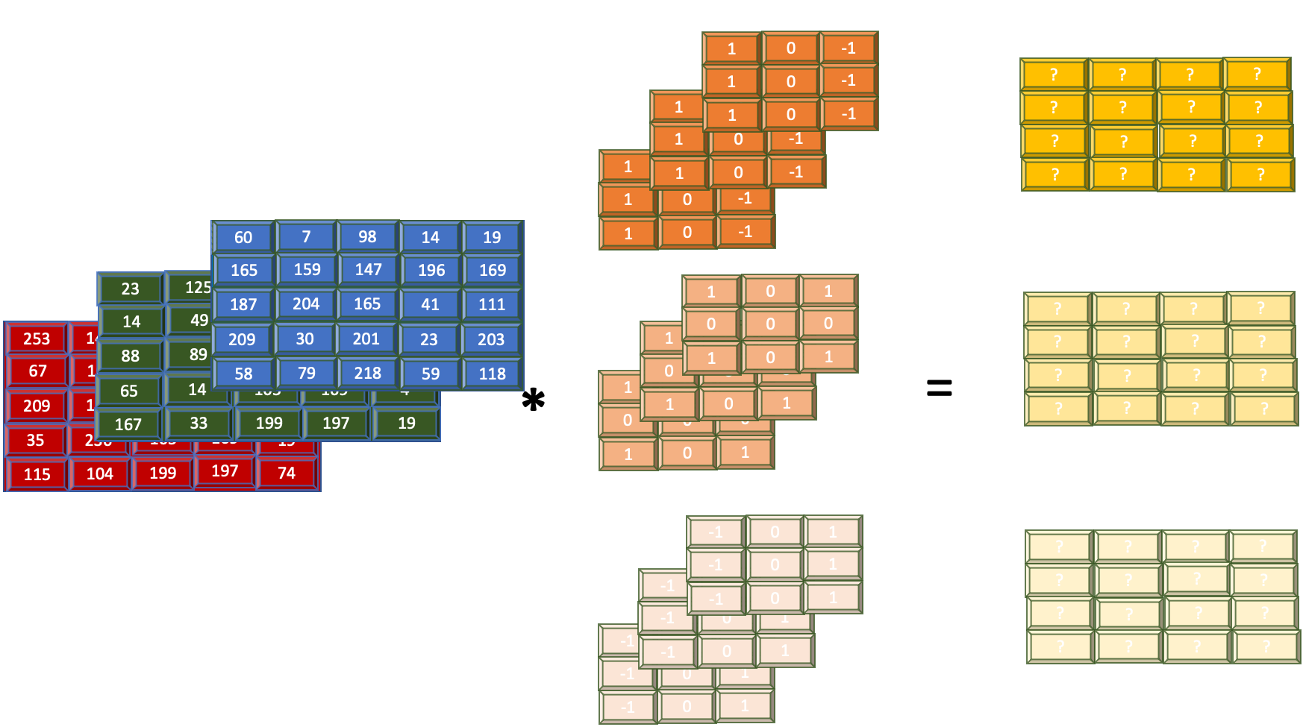
How Convolution applied to more than one filter???

Slide 14
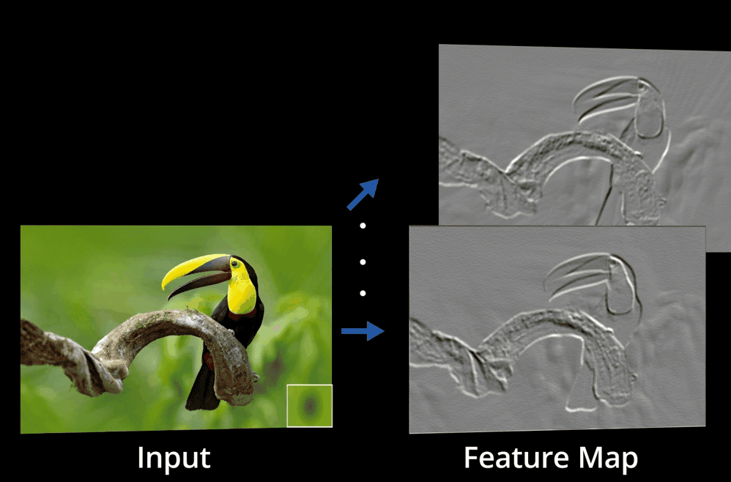
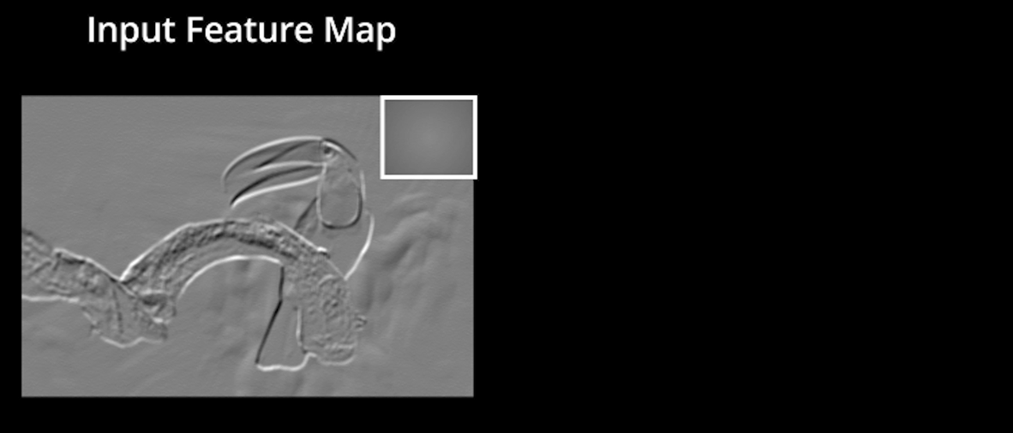
ReLu Layer –Rectified Linear Unit…

Slide 15
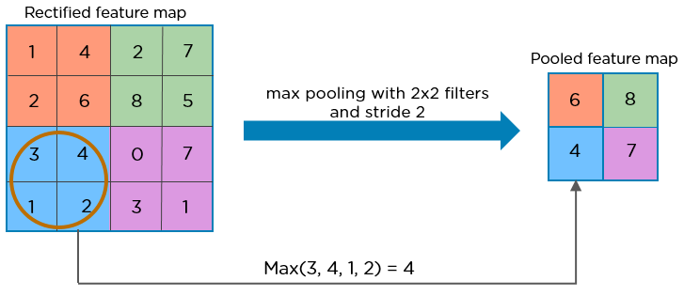
Pooling Layer…

Slide 16
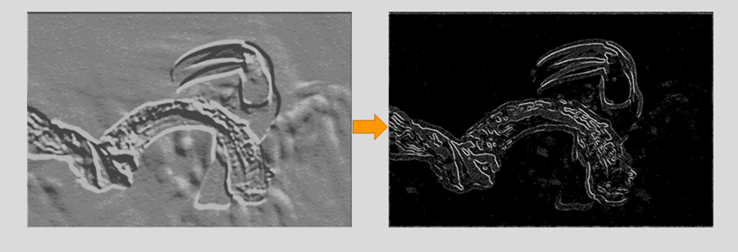
Pooling Layer
The pooling layer uses various filters to identify different parts of the image like edges, corners, body, feathers, eyes, and beak.

Slide 17
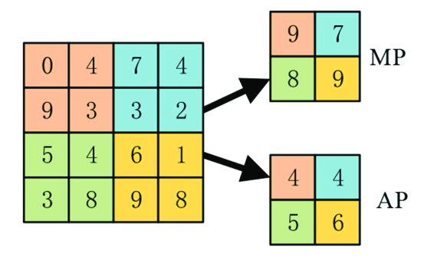
Pooling Layer types…

Slide 18
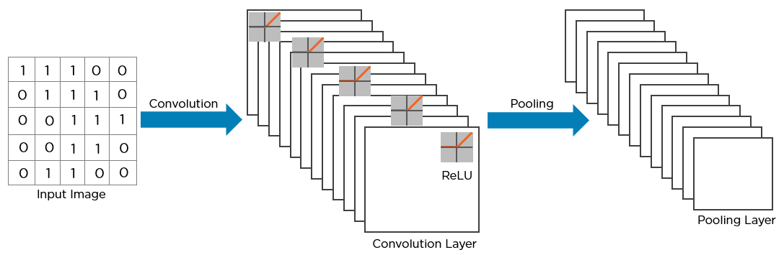
How Convolutional Network look so far…

Slide 19
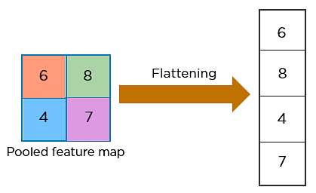
Flattening…

Slide 20
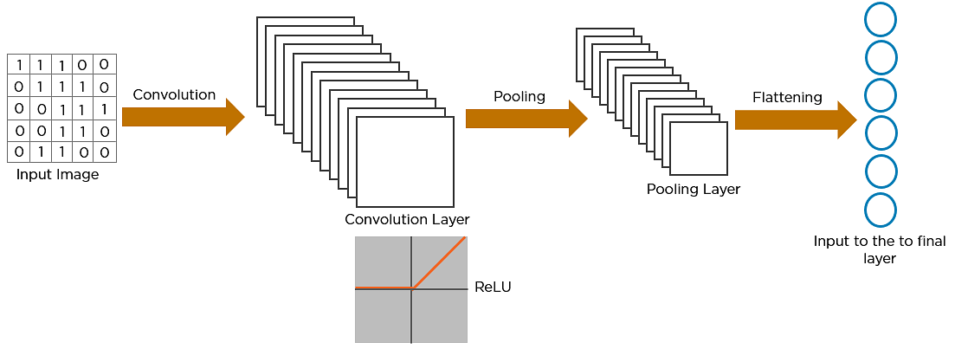
Fully connected Layer…

Slide 21
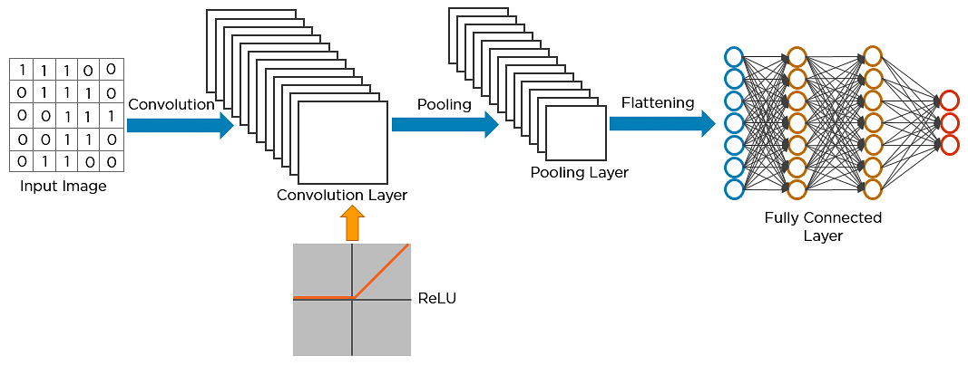
Fully connected Layer…

Slide 22
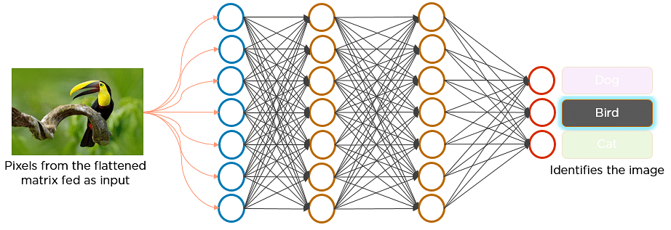
Fully connected Layer…

Slide 23
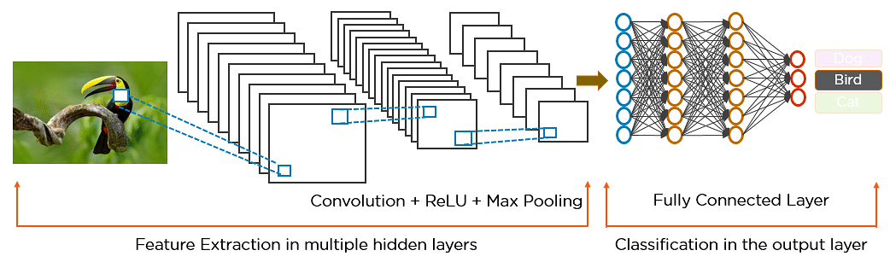
How exactly CNN predicts…

Slide 24




USE CASES OF CNN
Decoding Facial Recognition
Analyzing Documents
Understanding Climate
Advertising

Slide 25
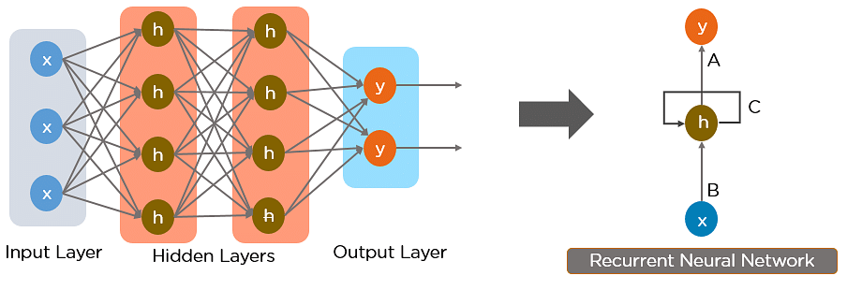
What is a Recurrent Neural Network (RNN)?

Slide 26


RNN Scenarios…

Slide 27
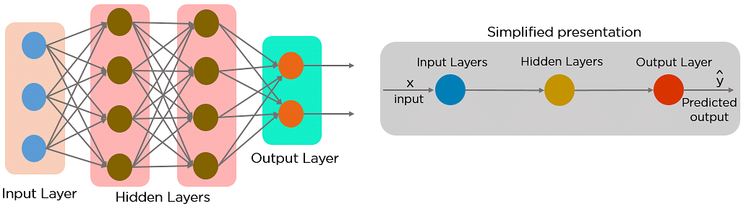
Feed Forward Neural Network …

Slide 28
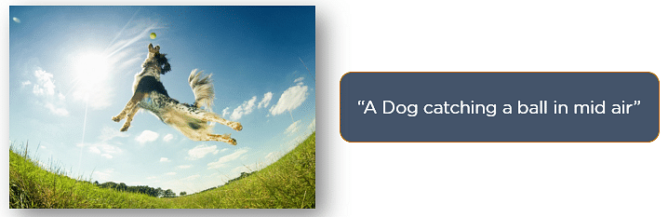
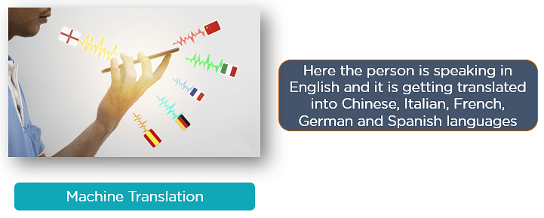
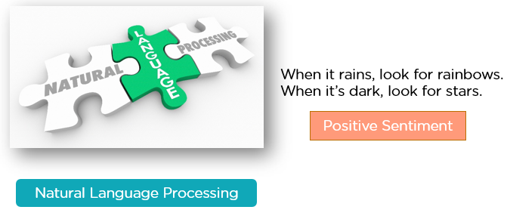

Slide 29
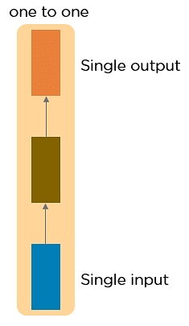
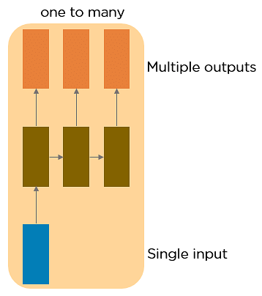
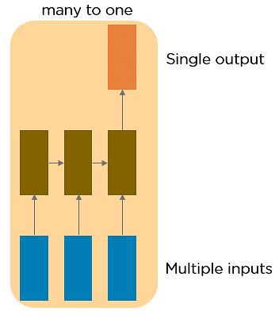
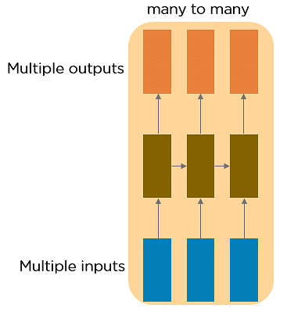
Types of RNN…
Vanilla Neural Network

Slide 30
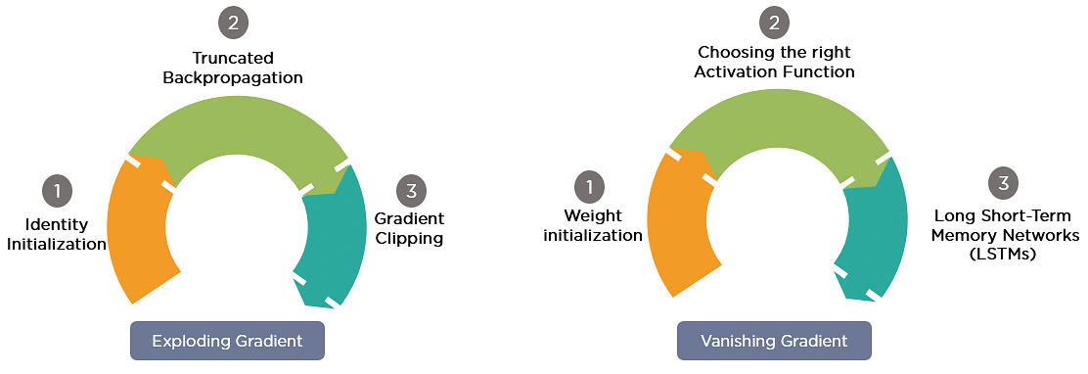
Two Issues of Standard RNNs and Solutions

Slide 31
“The clouds are in the ______.”
“I have been staying in TamilNadu for the last 10 years…I can speak fluent ______.”

Slide 32


Slide 33


Slide 34
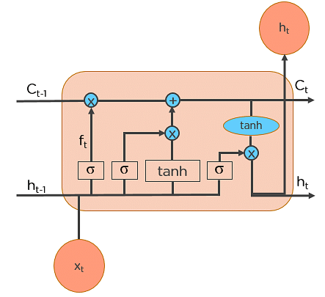
LSTM’s

Slide 35
 | CNN (Convolutional Neural Network) | RNN (Recurrent Neural Network) | LSTM (Long Short-Term Memory)
Suitable for | Grid-like structured data (e.g., images) | Sequential data (e.g., text, speech) | Sequential data with long-term dependencies
Key feature | Convolutional layers for local feature extraction | Recurrent connections for sequential information | Memory cells for capturing long-term dependencies
Architecture | Consists of convolutional layers and pooling | Consists of recurrent layers | A specialized type of RNN with LSTM memory cells
Information flow | Forward and occasionally backward | Unidirectional or bidirectional | Unidirectional or bidirectional
Memory | Limited memory, typically local context | Hidden state carries past information | Memory cells store past information and gate it

Slide 36
Weaknesses | Limited sequential modeling, global context | Difficulty capturing long-term dependencies | Computational complexity, overfitting with small data
Common applications | Image classification, object detection | Sentiment analysis, language modeling, speech recognition | Natural language processing, machine translation

Slide 37

THANK YOU
Queries???

